Slide 1
Draw a flowchart representing the logic of a basic online registration system.simple word pade diagram with all detail explain.

Slide 2
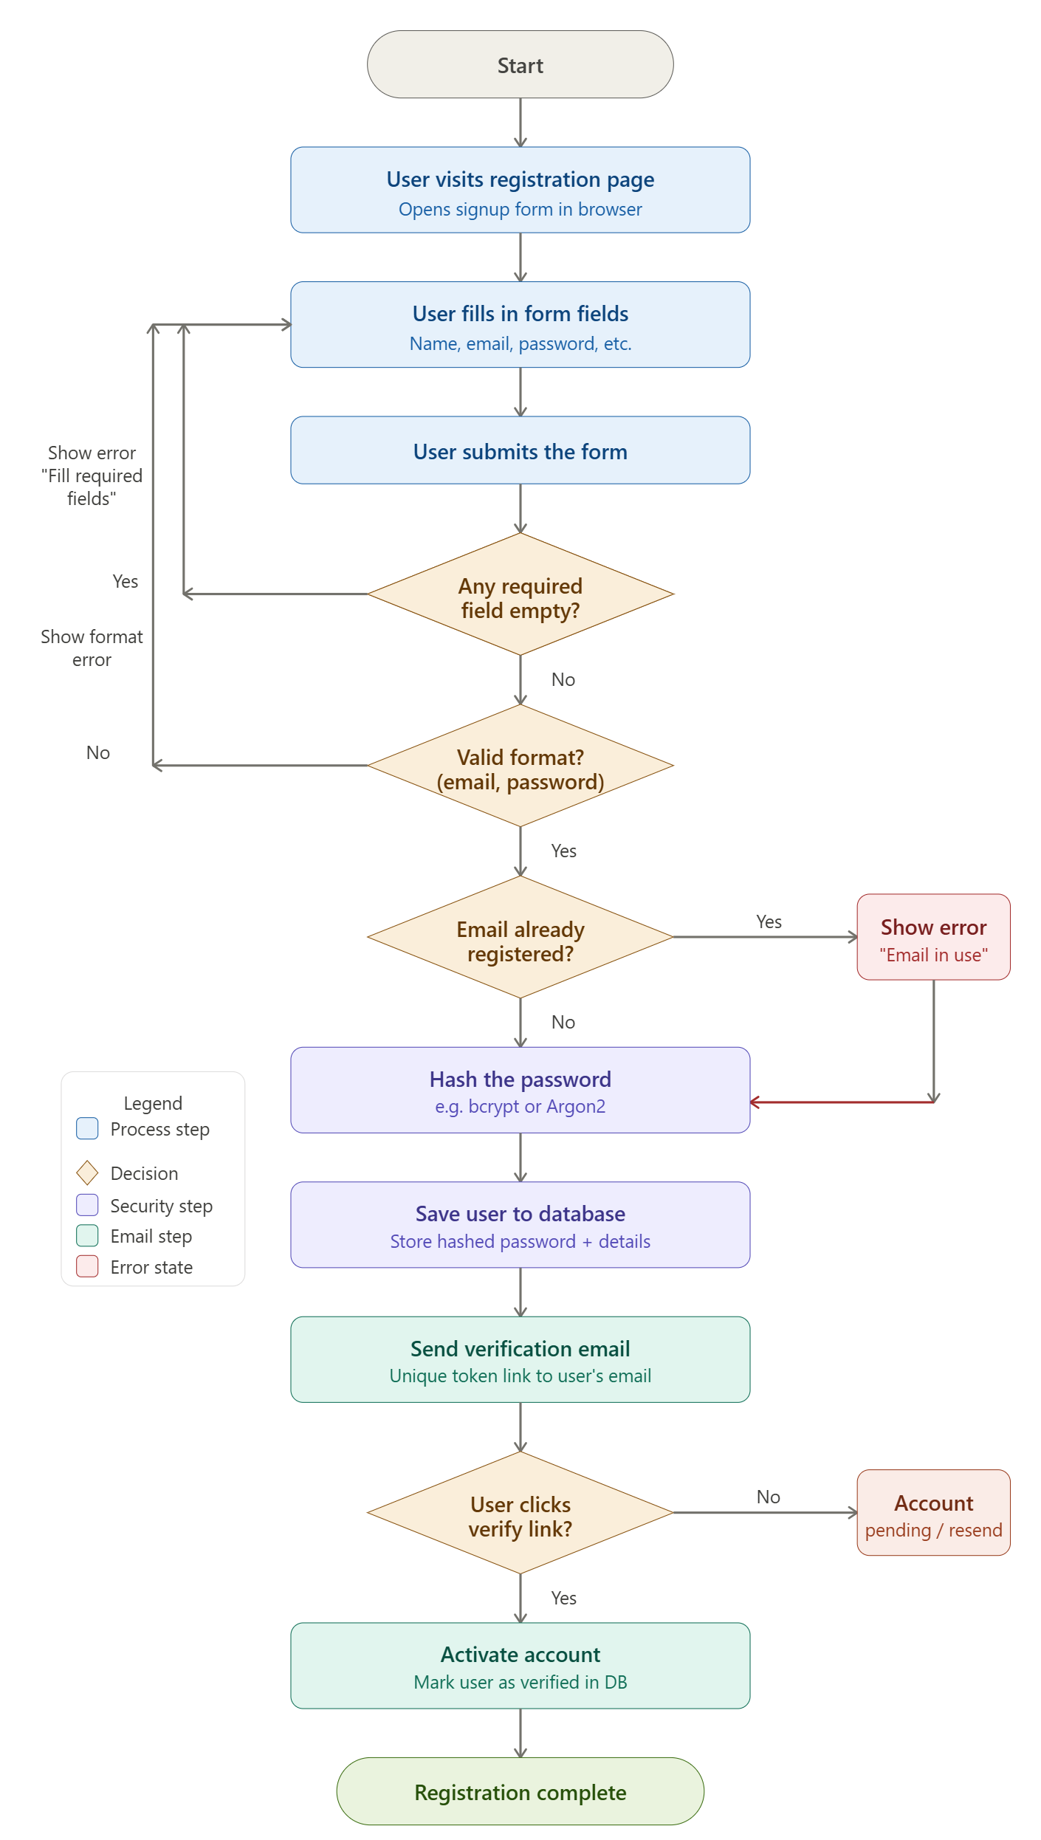

Slide 3
Here's the complete flowchart for a basic online registration system. You can click on any box or diamond to learn more about that step. Here's a breakdown of what each section represents:
Flow summary (top to bottom):
User visits the registration page — the entry point, where the signup form is displayed.
Fill in & submit the form — the user enters their name, email, password, and other details.
Validation checks (amber diamonds):
Required fields empty? — if yes, an error is shown and the user is sent back to the form.
Valid format? — checks that the email is well-formed and the password meets the rules. Errors loop back to the form.
Email already registered? — queries the database; if a match is found, a "email in use" error is shown.
Security step — password hashing — the plain-text password is never stored; it is hashed using a secure algorithm like bcrypt.
Save to database — the user record (name, email, hashed password) is written to the system.
Email verification — a unique token link is sent to the user's email address.
Verify link clicked? — if the user clicks the link, the account is activated. If not, the account stays in a pending state and a resend option is offered.
Registration complete — the user is now fully registered and can log in.

